Slide 1
CSC 453 Project: Sleep Tracker
By: Shengdong Chen, Alex Grisham, Matt McLaughlin, Bilal Mohamad, and Yizhuo Wu

Slide 2
Presentation Overview
Project Introduction
Requirements
Overall Design
Raspberry Pi Circuitry
Front-End Design
Challenges
Demo

Slide 3
Sleep Tracker
Monitor noise and movement in an area to track the sleep patterns of the user
Utilizes a Raspberry Pi, an infrared motion sensor, a sound sensor, MQTT, and Python
Notes:
Need to finish or delete

Slide 4
Requirements
Detect any noise
Detect motion
Display data to the user
Calculate and display total sleep time
Notes:
Create something that could:
noise - sound sensor (or a microphone)
motion - uses infrared to detect motion
UI - display data
Total sleep

Slide 5
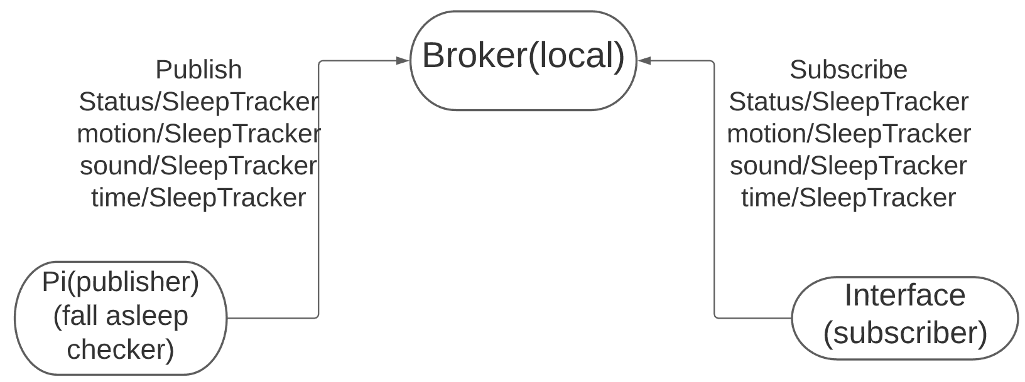
Overall Design
Notes:
Three main components:
Raspberry Pi: The main component for our project. This utilizes the movement and sound sensors to publish information to the broker as the user makes noise or moves throughout the night.
Broker: traditional MQTT broker
Interface: The interface, coded in Python using the PySimpleGUI package, is a subscriber to the broker in order to receive the information from the components on the Raspberry Pi. Using the PySimpleGUI package, it updates a display to the user counting the number of times motion and noise are detected.

Slide 6
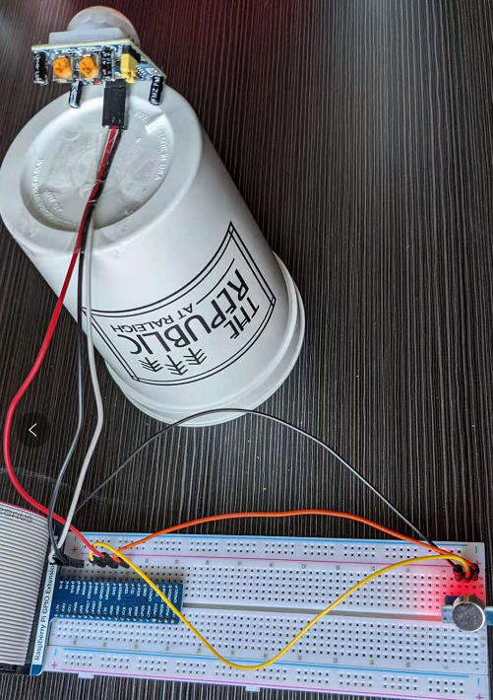
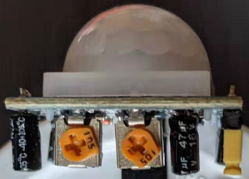
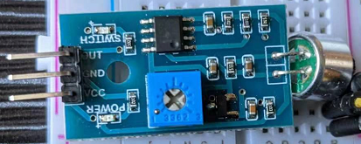
Circuitry and Components

Slide 7
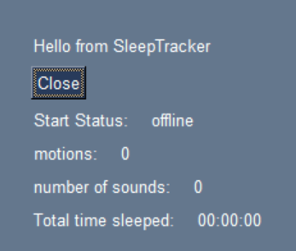
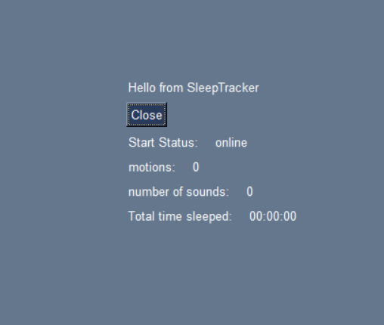
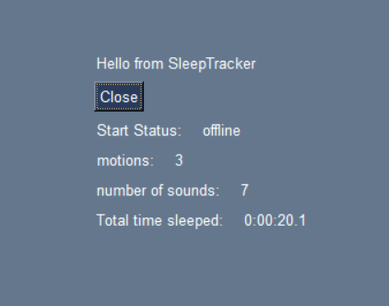
User Interface
Notes:
UI subscribes to the broker
Raspberry Pi has started and is collecting data
The program is terminated and the UI updates with the information that was collected while online

Slide 8
Challenges
Circuitry
Determining the correct sensitivity and threshold values for the motion and sound sensors
User Interface
Finding a suitable library
Updating statistics in real time
Connecting to MQTT
Testing
Working remotely

Slide 9
Video Demonstration

Slide 10
Thanks for watching!
By: Shengdong Chen, Alex Grisham, Matt McLaughlin, Bilal Mohamad, and Yizhuo Wu

